Slide 1
Welcome! I’m so glad you’re here!
While we’re waiting for everyone to arrive, please do the following:
On your desk is a nametag. Please write your first name on it and place it on the front of your shirt. Mrs. Bobrow wants to learn your name!
Please be thinking about the kind of morning you had before you arrived at school. Was it good? Was it not so good? What happened that made you feel that way?

Slide 2
Meet Your School Counselor
Bel Air Middle School
Mrs. Bobrow, 6th Grade School Counselor

Slide 3
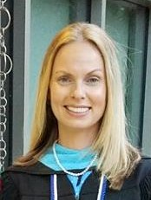
Who is my school counselor?
Mrs. Bobrow

Slide 4
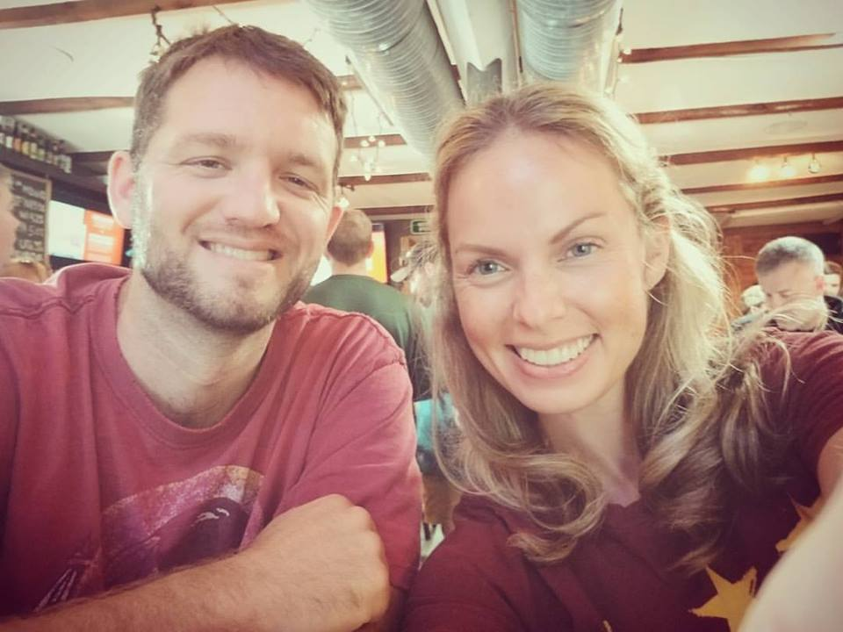
Mrs. Bobrow: Family

Slide 5
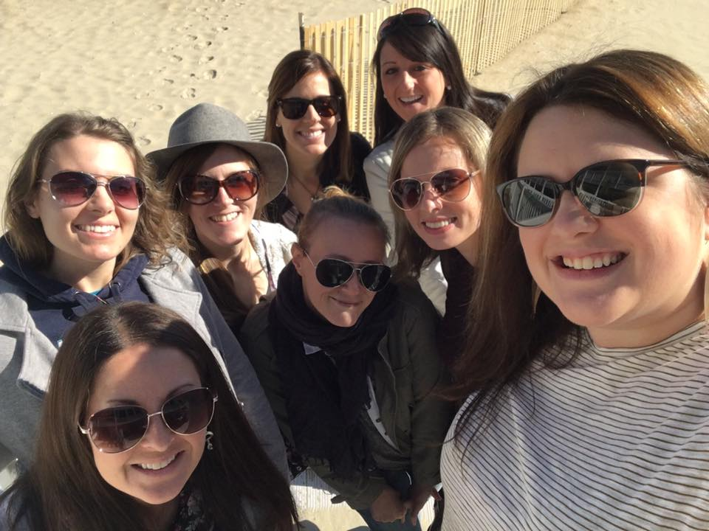
Mrs. Bobrow: Activities

Slide 6


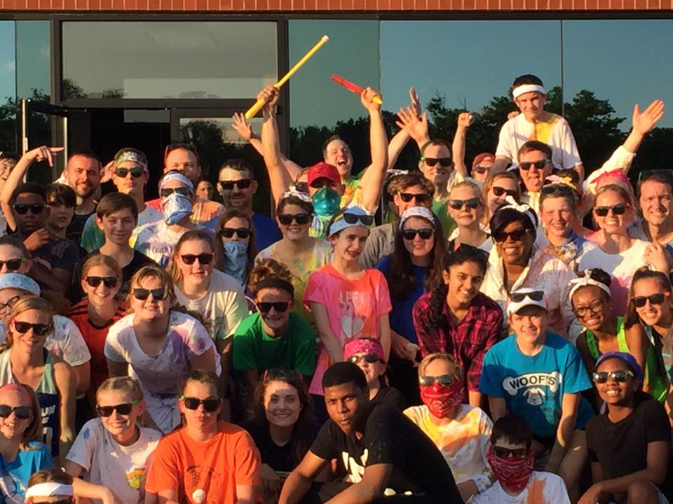
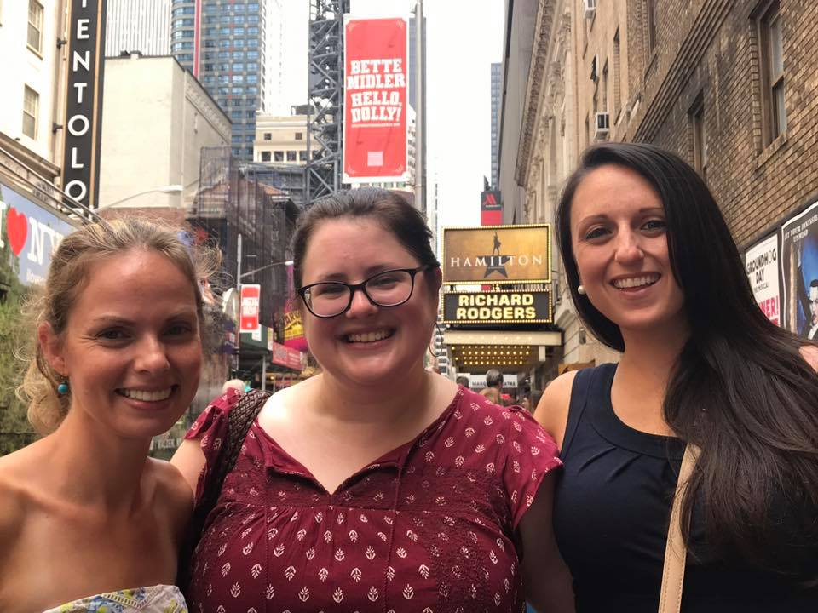
Mrs. Bobrow: Activities

Slide 7


Mrs. Bobrow: Food

Slide 8
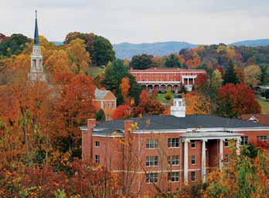
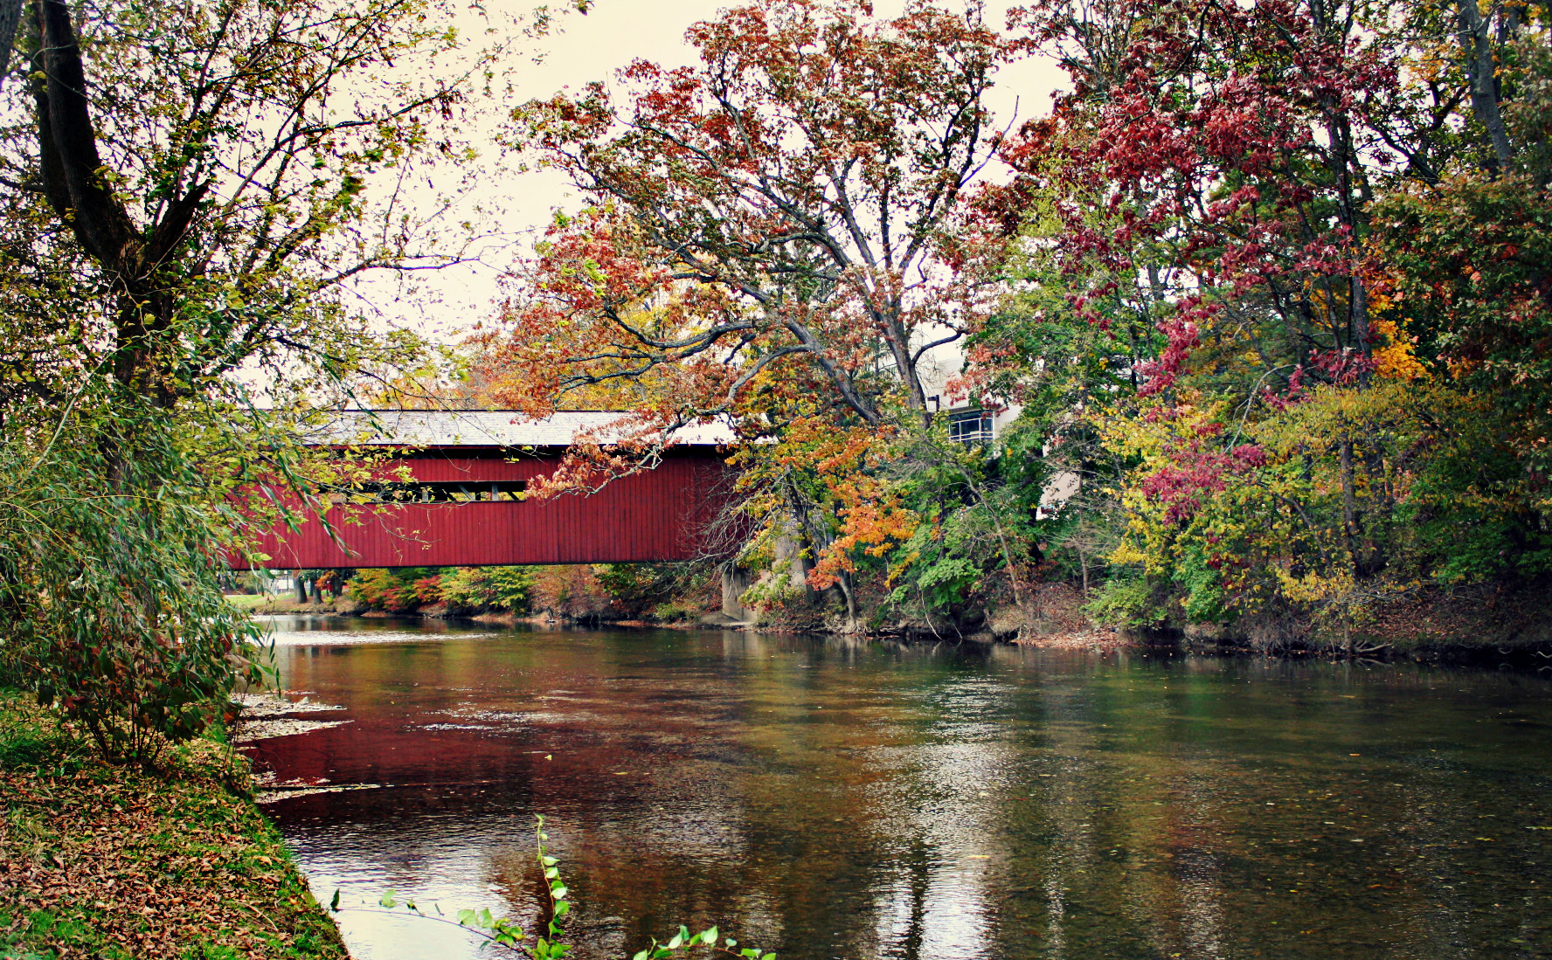
Mrs. Bobrow: Education
K-12
Bachelor of Science: Early Childhood Development
Bachelor of Science: Middle Grades Education
Bachelor of Science: Psychology
Master of Arts: School Counseling
Clinical and Mental Health Counseling
Certifications: School Counselor
National Board Certified Counselor (NBCC)
Licensed Graduate Professional Counselor (LGPC)

Slide 9
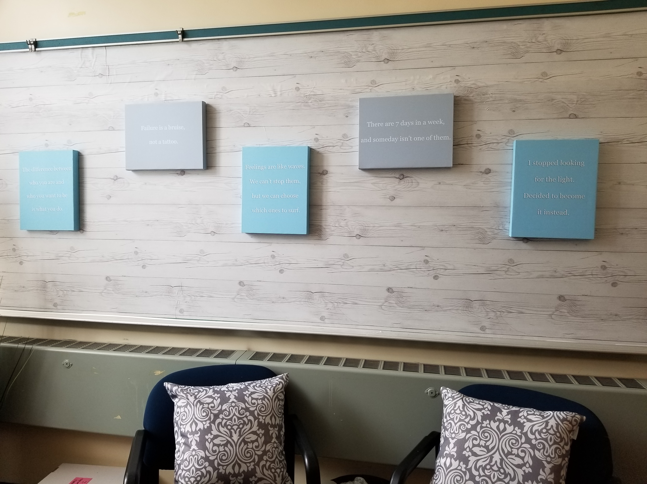
How do I make an appointment to see Mrs. Bobrow?
1. Come to the School Counseling Office (by the main office entrance)
2. Mrs. Bobrow may be in her office, and you can see her right away.
3. If I am not in my office, ask Ms. Russo if you can make an appointment to see me.
4. You will fill out a blue pass (your name, the date, your homeroom, a general idea of what the problem is, and if it is an emergency.
5. Mrs. Bobrow will get the pass, fill in a time to come see her, and place it in your homeroom teacher’s mailbox.
6. Your homeroom teacher will give it to you the next day, and you will come see Mrs. Bobrow at that time.

Slide 10
When Mrs. Bobrow needs to see me
Mrs. Bobrow will NEVER get a student from class because that student is “in trouble”
A teacher might refer a student to Mrs. Bobrow
A parent might refer a student to Mrs. Bobrow
A friend might refer a student to Mrs. Bobrow
Other reasons Mrs. Bobrow might ask you to come to the Counseling Office:
Schedule Changes
Check-Ins
New Student Help

Slide 11

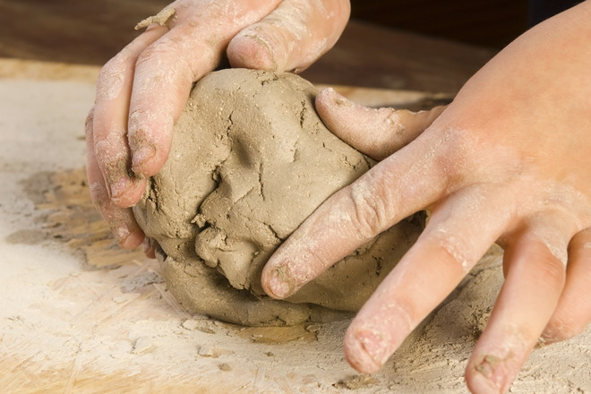
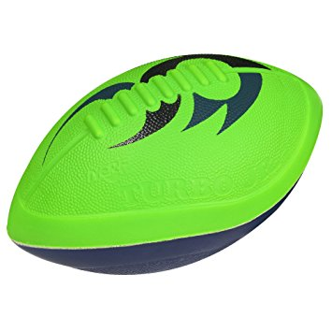
What will I do in Mrs. Bobrow’s office?
TALK
Color or Draw
Play Catch
Sculpt
BE HEARD
Individual Counseling
Groups
Peer Mediation

Slide 12
Groups
Anxiety
Divorce
Grief and Loss
Habits for Health
Girls’ Friends Group
Boys’ Friends Group
How to Make a Friend
Organization/Planning for Success (includes study skills)

Slide 13
Something to know: Confidentiality
What you say to Mrs. Bobrow does not get shared with anyone, UNLESS:
Someone is hurting you
You want to hurt someone else
You want to hurt yourself
You give me permission to share the information with a trusted adult.
*I care about you very much, so I want to keep you safe.*

Slide 14
So, what can mrs. Bobrow help with?
1. Get help solving conflicts – Sometimes it’s hard to manage conflicts on your own. I can help you brainstorm solutions to your conflicts.
2. Get help with managing your busy schedule – Life can get really hectic between school, friends, sports, and other extracurricular activities. I can give you tools to help you manage your time wisely.
3. Get help with making goals for this year– Making goals can sometimes be overwhelming. I can guide you to the right path in order to accomplish your goals.
4. Talk about college and career choices – Once I get to know you, I can help you identify colleges and post-secondary training opportunities that would be a good fit for you.

Slide 15
So, what can mrs. Bobrow help with?
5. School counselors write awesome letters of recommendation – Sometimes, you will want to do something that will ask for a letter of recommendation to accompany your application.
6. Get help making important decisions – Decisions can be hard to make on your own. I can give your guidance in making those choices.
7. You want to do better in school – Some classes are tougher than others, I can help connect you with a tutor.
8. You just want to talk to someone who will listen – Many things happen throughout the day, some good, and some bad. I am always available to listen.

Slide 16
What Mrs. Bobrow Can’t Do
Make everything better INSTANTLY: Good things take time
Just GIVE you the answers: That won’t help you
MAKE people be nice: We can only control ourselves

Slide 17
What Mrs. Bobrow WILL do
HEAR you
HELP you see a problem from a different angle
Ask questions so I can understand the world from your perspective
Middle school is tough…
BUT SO ARE YOU!

Slide 18
We’re going to listen to a song…
Click HERE for the Song

