Slide 1
Welcome! I’m so glad you’re here!
Please do the following to be ready for a great class together:
Clear your desk of everything but a pen/pencil and your notecard.
Using the notecard provided, write down a few words that you think of when you hear the word “Conflict”.
Be prepared to share your thoughts with the class

Slide 2
Conflict: How to Deal
Mrs. Bobrow, School Counselor

Slide 3
Objectives
Today I will…
Define “conflict” so I can better know how to address it
Identify conflict that I can handle on my own
Understand steps I can take that will help me better handle future conflicts
Practice using strategies to help resolve a conflict
Let’s talk about those cards!

Slide 4
What is Conflict?
A serious disagreement or argument
Usually results in at least one person feeling hurt, rejected, or betrayed
Can change the way someone sees him/herself or how others see that person

Slide 5
Types of Conflict
Verbal Aggression
Name calling
Threats
Exclusion
Rejecting
Uninviting/Not inviting
Gossip
Spreading rumors
Refusal to let someone be part of the group
Insults/Packing
Telling other people’s personal information

Slide 6
Question: When have you been involved in a conflict like this?
Briefly describe the situation on the notecard you used at the beginning of class. Please consider:
Who was involved?
What was the conflict about?
What was the end result?
How do you feel NOW when you think back to that conflict?

Slide 7
Strategies for Handling Conflict

Slide 8
Strategy 1: Tell the Person to STOP
Look the person in the eye
Be specific
Be direct
Example: “Please stop saying my shoes are ugly.”

Slide 9
Strategy 2: Use “I” Statements
Expresses that what someone is doing to you is hurting you in some way.
Example: “I feel SAD when you SAY MY SHOES ARE UGLY because IT EMBARASSES ME.”

Slide 10
Strategy 3: Ignore It
Do not react verbally
Do not show a physical response
Take some deep breaths
MUST be consistent

Slide 11
Strategy 4: Take a Break
Sharpen your pencil
Ask your teacher if you can get a drink of water
Ask your teacher if you can work at another desk

Slide 12
Strategy 5: Make a Deal
Both people agree to something to stop the conflict.
“I will stop packing on you if you stop making fun of my shoes.”

Slide 13
Strategy 6: Mediation
When you’ve tried at least two of these strategies
Conversation between you and the other person
With Mrs. Bobrow (or another trusted adult)

Slide 14
Let’s Practice Together!
In each of these clips, there is a conflict.
Who is the conflict between?
What is the conflict about?
What strategy would you recommend to help the conflict resolve?

Slide 15
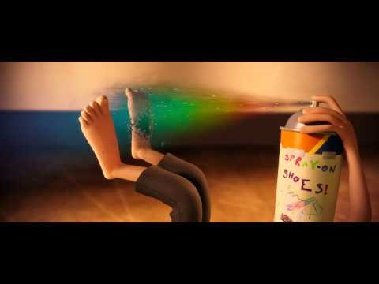
Clip 1: Invention

Slide 16
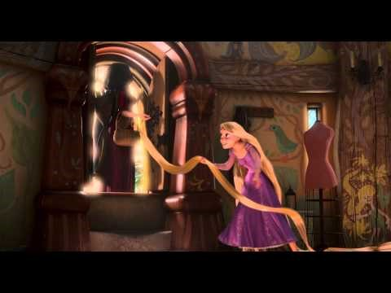
Clip 2: Mother Gothel

Slide 17
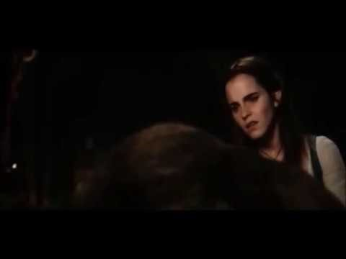
Clip 2: Control Your Temper

Slide 18
Your Turn! From the scenario, please tell us…
Who is involved in the conflict?
What is the conflict about?
What strategy could be used to help resolve the convlict?
How might this end?

Slide 19
Questions?

